Slide 1
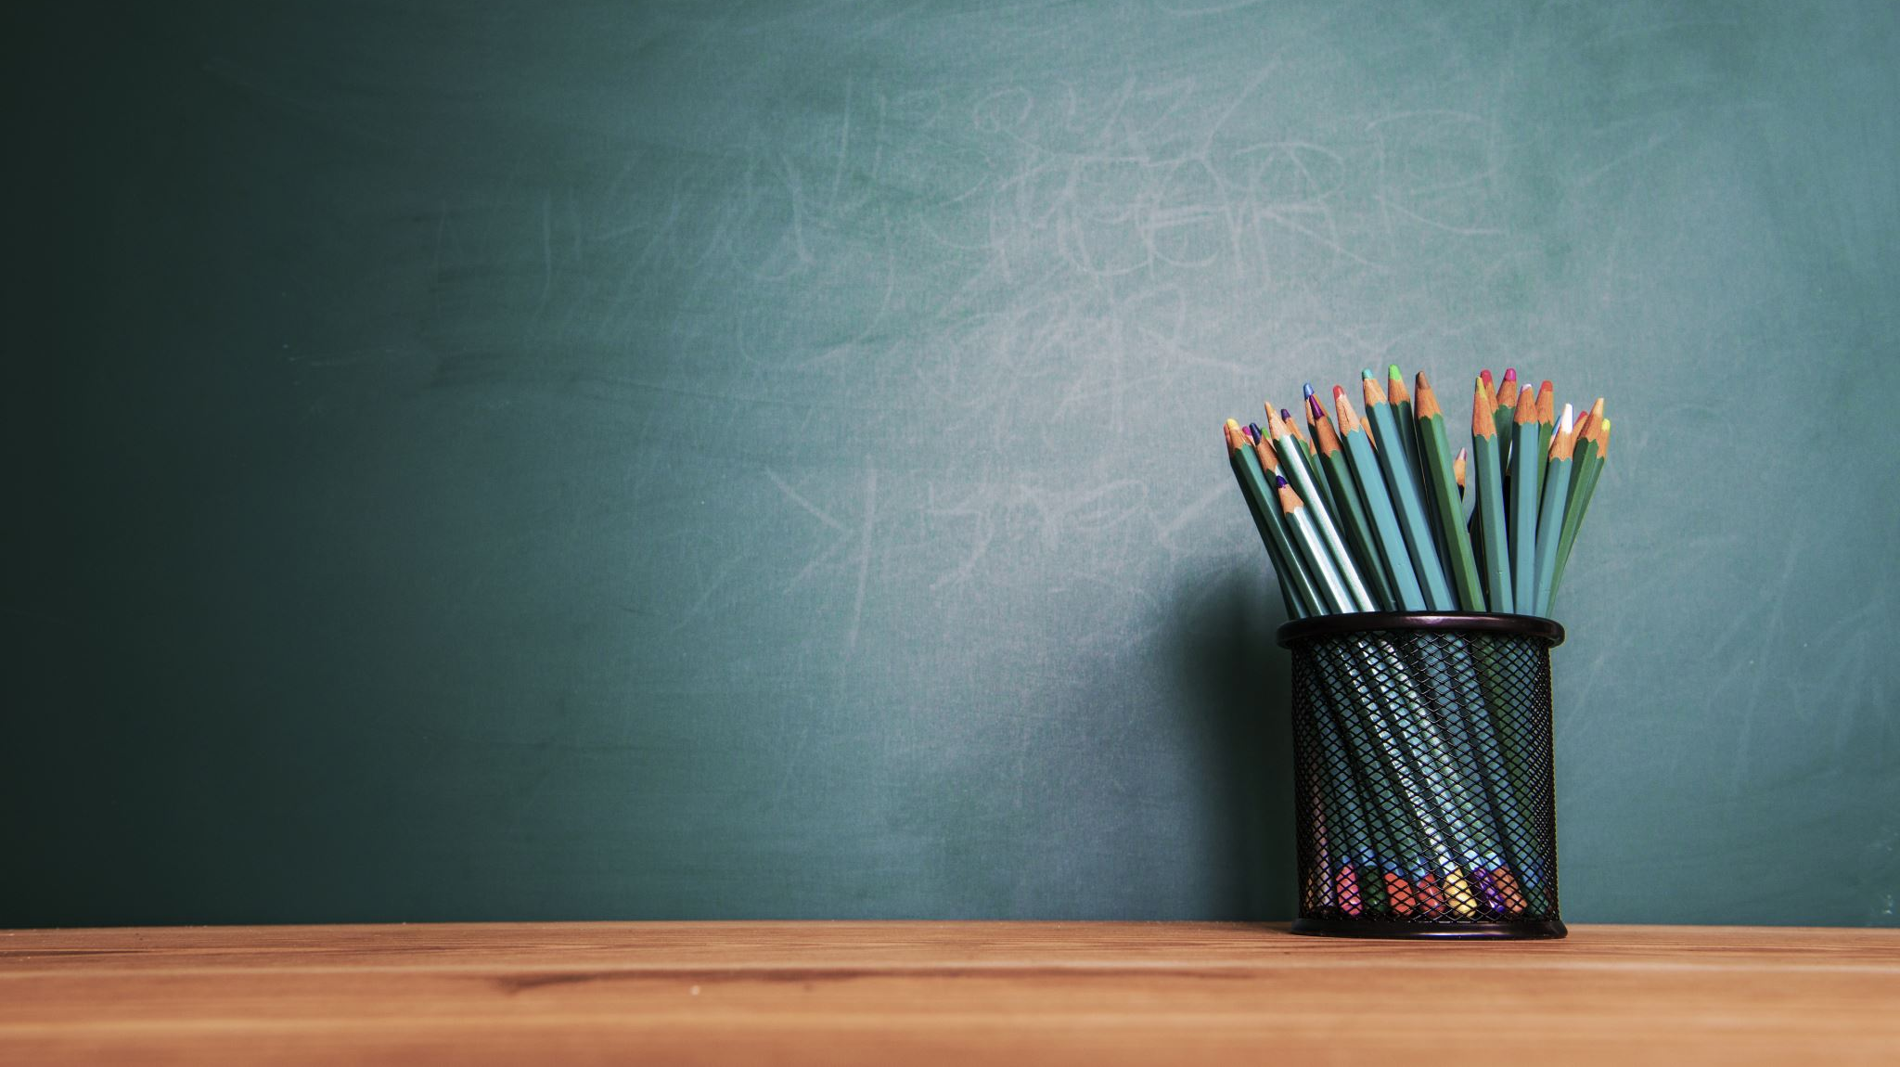
Welcome to Year 2
Miss Colbourne
Mrs Hardie
Mr Low

Slide 2
Information & Notices
Year 2 class page on the school website:
http://www.stjamesmanchester.co.uk/year-2.html

Slide 3
Timetable
 | 9.05 – 10.00 | 10.00 – 10.30 | 10.30 - 10.45 | 10.45 - 11.00 | 11.00 – 12.00 |  | 12.00 - 13.00 | 13.05 - 14.00 | 14.00 - 14.15 | 14.15 - 15.00 | 15.00 - 15.20
 |  |  |  |  | 11 - 11.30 | 11.30 - 12
Mon | English | Phonics | Assembly | Play time | Maths |  | Lunch time | Art | Play time | Geography
Tues | English | Maths | Assembly |  | Maths | Phonics |  | Guided Reading |  | Science
Wed | English | Spanish | Assembly |  | Maths | Maths |  | Outdoor Games |  | Guided Reading | Indoor PE
Thurs | English | Maths | Assembly |  | Maths | Phonics |  | Computing |  | RE | Practise Reading
Fri | Assembly | English | Maths | Play | Maths | Phonics |  | Music |  | PSHE | Golden Time
* Blue = Taught by Mr Low

Slide 4
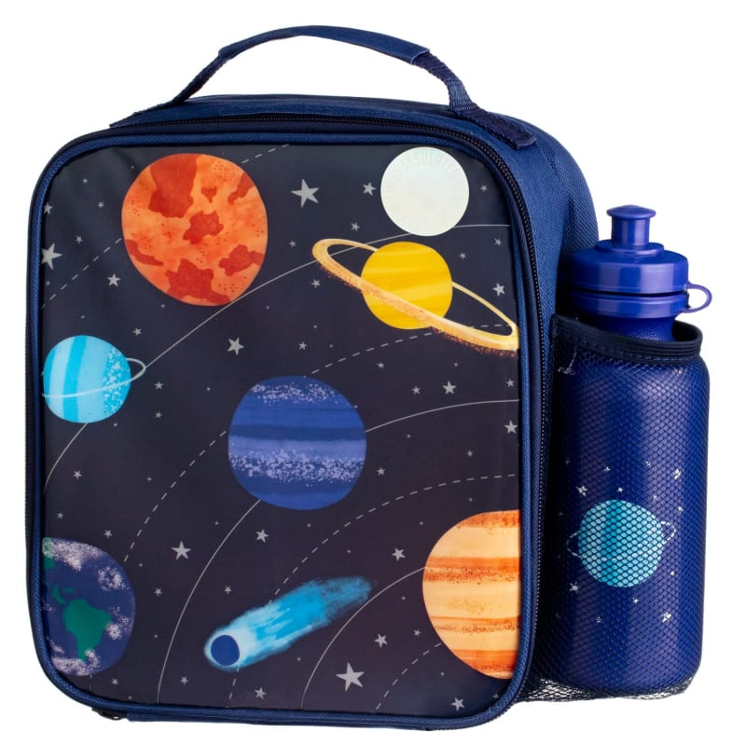
What to bring to school?
Book bag – with all reading books
Water bottle (please keep out of book bags)
Packed lunch
Do not need to bring fruit.
Please do not bring large backpacks as we have limited space.
Please do not bring any other personal belongings, e.g., toys, stationery, jewellery, stickers.

Slide 5
Uniform – please label all belongings
Everyday
PE
Black trousers or skirt
Black shoes
Shirts or polo top – blue, white or yellow
School jumper or cardigan – Royal Blue
Please no jewellery (unless for religious reasons)
Black bottoms – jogging bottoms, leggings, shorts
White top or t-shirt
Trainers or outdoor shoes
Please no hoodies
PE kits are kept in school in a small, labelled bag and will be sent home every half term.
Wednesdays PM

Slide 6
What we are learning this half term:
Phonics: Summer 2; Phase 5
English: Description writing,
Instructions
Maths: Place value, Shape,
Addition & Subtraction
RE: Who is Muslim and how do they live?
Music: Hands, Feet, Heart
Art: Landscapes and Cityscapes
Science: Use of Everyday Materials
Indoor PE: Dance - Water
Outdoor PE: Dodging
Computing: Presentations
PSHE: Mental and Emotional Health
Geography: Magical Mapping
* Blue = Taught by Mr Low

Slide 7
Homework & Reading at Home
Homework
Reading
Homework will be given out on a Friday in their orange homework books and is to be returned on a Wednesday.
There will be Maths and English homework sheets each week.
eBooks are changed on a Monday – new book and the previous week’s book.
Reading books are changed on a Tuesday – they will have 2 books each week.
Please record reading in the reading record.

Slide 8
SATs
In summer term of year 2, we will have SATs – these are nationwide tests to see where children are up to at the end of KS1.
Writing – this is teacher assessed across the whole year.
Reading –children will sit 2 papers and reading will also be teacher assessed across the year.
Maths – children will sit 2 papers: Arithmetic and Reasoning. They will also be teacher assessed across the year.

Slide 9
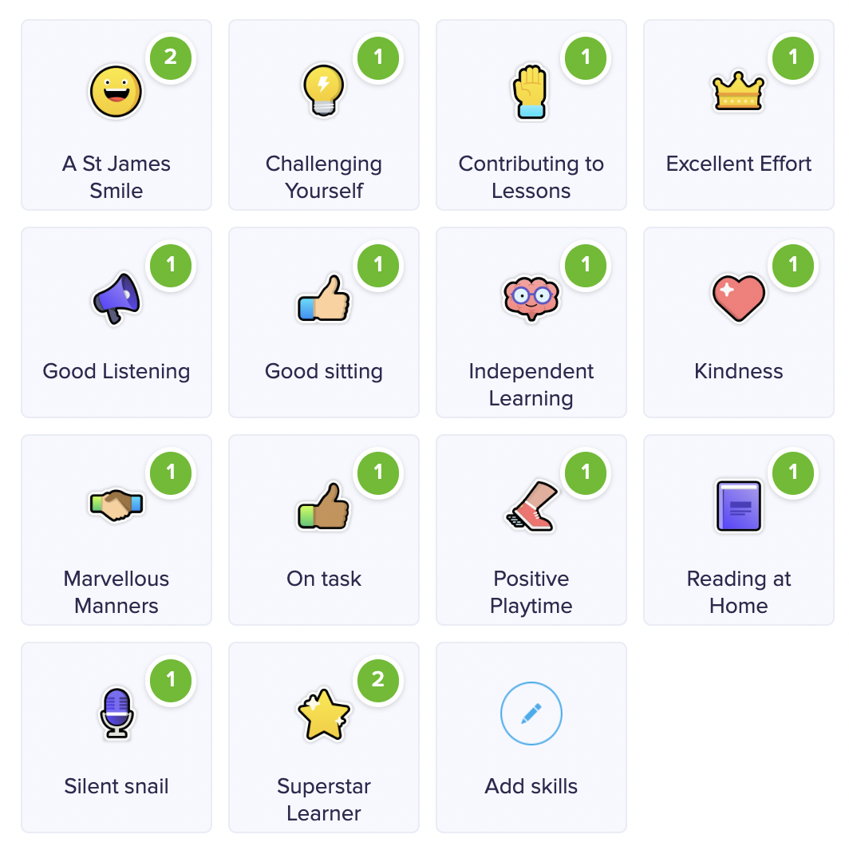
Behaviour
ClassDojo: Children receive Dojo points for positive behaviour.
Daily, weekly and yearly prizes for dojo points.
Superstar Learners: At the end of each lesson, I choose a child who has contributed, concentrated and worked hard during the lesson: this child receives 2 Dojo Points.

Slide 10
Behaviour
Celebration Assembly: On a Friday morning, 4 children from each class are awarded certificates:
Bee Kind Award
2x Star Awards
1x Headteacher Award
Behaviour policy: For non-positive behaviour, children are provided with a warning, if the behaviour continues children will receive either a yellow or red card:
Yellow: miss 5 minutes of break time whilst reflecting on behaviour with class teacher.
Red: miss 5 minutes of break time whilst reflecting on behaviour with SLT and parents are informed.

Slide 11
Any questions?
l.colbourne@st-james-rusholme.manchester.sch.uk

