Slide 1
Meet the team
Mr Roberts
Mrs Melia

Slide 2
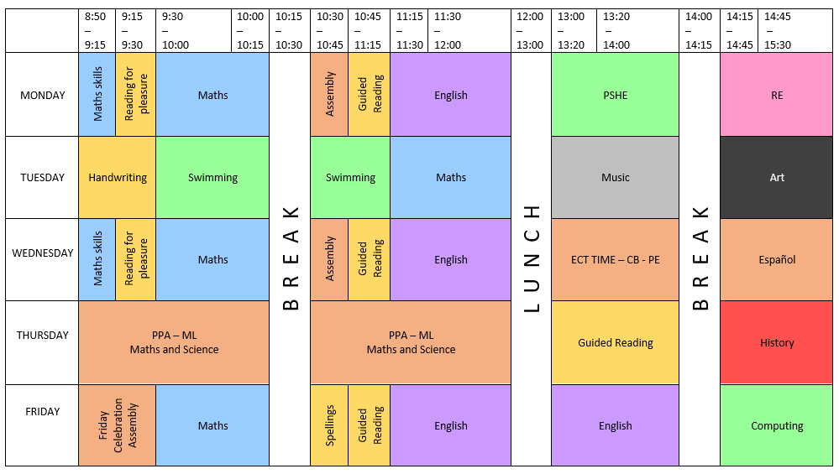

Slide 3
Swimming, pe and forest school
Swimming
Children have swimming on a Tuesday morning which they are taken to by myself and Mrs Melia. You should have received a letter about this, a copy of it is available on the Year 4 webpage. Please make sure children bring the correct swim kit every Tuesday.
PE
PE will take place on a Wednesday afternoon and we will be learning netball for the first half term in Year 4 with a focus on throwing and catching. Please make sure children bring their PE kit in on a Wednesday or earlier.
Forest School
Children will also be taking part in forest school every Thursday for one half term, either for the full morning or the full afternoon depending on which group they are in. They will need spare cloths and spare shoes as they will get muddy!

Slide 4
Reading: books and reading records
Children have all been give a reading record to keep track of their reading and we encourage them to read, even for a little while, every night.
Children will get a dojo for every day that they read at home and get their records signed off.
Additionally, every term we will check which children have been reading consistently and their names will be entered into a raffle to win a prize.

Slide 5
homework
Homework books will be given out on a Friday and is expected to be completed and returned by the following Wednesday.
Each piece of homework will include:
An English section, usually spellings that follow a rule that will be tested on a Friday.
A reading section, usually a reminder to read every week and fill out reading records.
A maths section, this can be times table practice or something related to the work we have been doing in class.
In addition to this, children have been set up with a Mathletics and a Times Table Rockstars account which will have work assigned as homework every week.

Slide 6
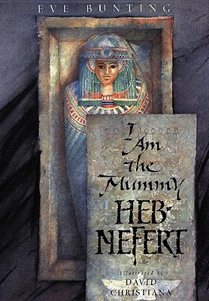

Slide 8
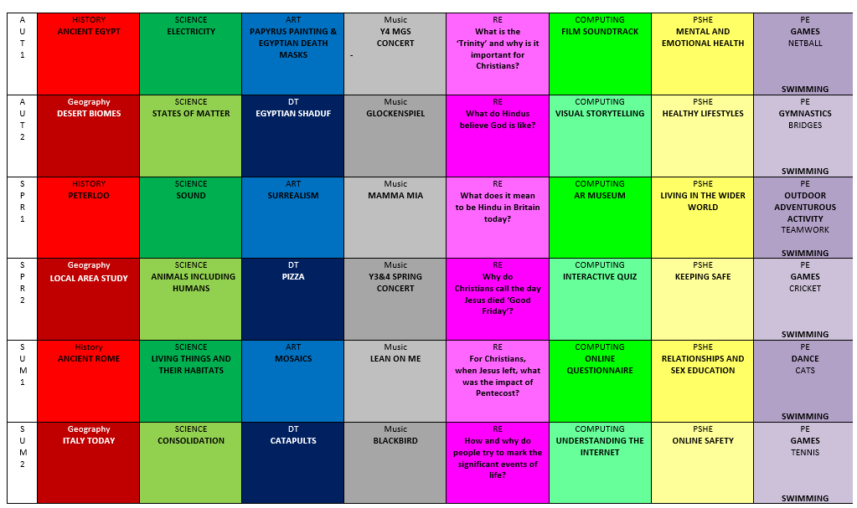
Topics

Slide 9
Rewards and Sanctions
Rewards
Marbles
Children have both collaborative and individual rewards.
As a class we have a marble jar which is emptied every Monday, the aim is to fill it back up by last lesson on a Friday. If they do so, they will get 15-30 minutes of golden time where lots of activities are available. This can be watching part of a film, having the opportunity to play with iPads, etc.
They can earn marbles by behaving well as a class: coming in from break time in a quiet and sensible manner, keeping their classroom tidy, trying their best with their classwork, generally following our class rules we agreed in July.
DOJOs
Children also get rewards in the form of DOJOs where each student has their own DOJO monster and whoever has the most DOJOs at the end of the week can pick a prize from the prize pyramid. DOJOs are reset every Monday, but children can also earn badges from their milestone totals over their time in school such as 250, 500, 750 and 1000.

Slide 10
Rewards and Sanctions
Sanctions
In school we also have a green card, yellow card, red card behaviour system.
All children begin on the green card.
Level 1 – Verbal warning and informing of consequence.
Level 2 – Yellow card, children complete a ‘Learning from Mistakes’ sheet at the start of lunchtime/break time and therefore miss part of their playtime. These are kept by the class teacher to monitor behaviour.
Level 3 – Red card, children spend up to 20 minutes in Key Stage Partner class.
Children complete a ‘Learning from Mistakes’ sheet at the start of lunchtime/break time and therefore miss part of their playtime. This sheet is shared with SLT by child and kept by SLT to monitor behaviour. Parents are fully informed of red card behaviours and incidents that have taken place during the school day.
Level 4 - Children will be placed on an Individual Behaviour Plan tailored to the individual child that will be monitored by SLT. Parents are fully informed and Individual Behaviour Plans are shared with them.

Slide 11
Multiplication tables test
The multiplication tables check (MTC) is statutory assessment for all year 4 pupils in England. Schools should administer the multiplication tables check within the 2-week period from Monday 3rd June 2023.
The check is to test if children can fluently recall their times tables up to 12 x 12, which is important for fully accessing many areas of the maths curriculum in upper key stage 2 (Years 5 and 6).
Children will have 6 seconds to answer each question in a series of 25. Each question will be worth one mark and be presented to the child in this format: n1 x n2 = ____
Children will be given the regular opportunity to practise answering questions in this format before the official check begins.

Slide 12
Diary dates
10th October 2023 – singing concert at MGS, children will perform alongside other Year 4 classes in Manchester.
3rd – 16th June 2023 – Children will be taking a nationwide multiplication test testing their knowledge of multiplications up to 12 x 12.

Slide 13
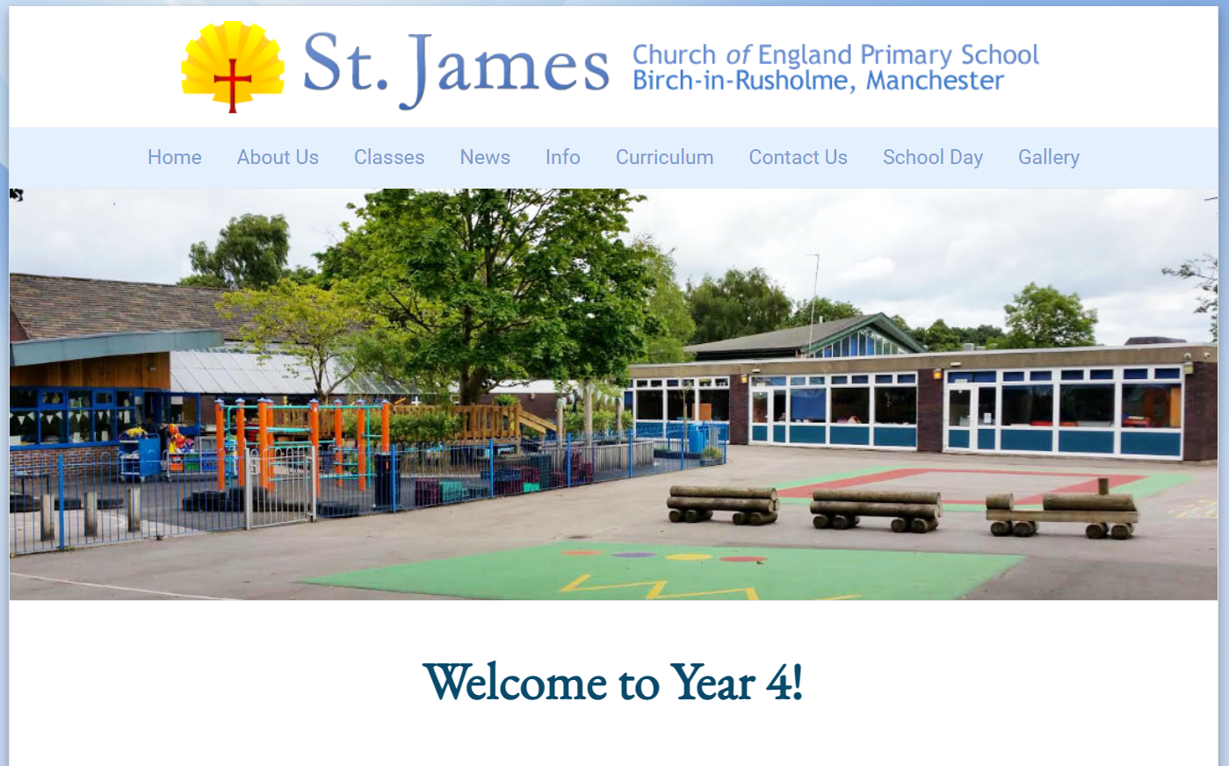
website
In addition to this evening, there will be all of this information available on the Year 4 page of the school website. This website will be updated regularly – at least every half term with all the information necessary.
http://www.stjamesmanchester.co.uk/year-4.html

Slide 14
Any questions
Please feel free to ask any questions I will answer as best I can.

